Slide 1
Final Presentation
Andrew Zhu

Slide 2
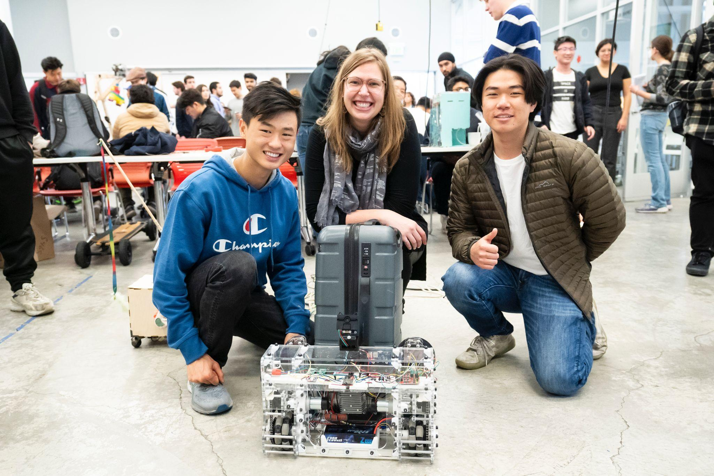
Project Porter
From left to right: Hubert Liu, Professor Stuart, Andrew Zhu

Slide 3
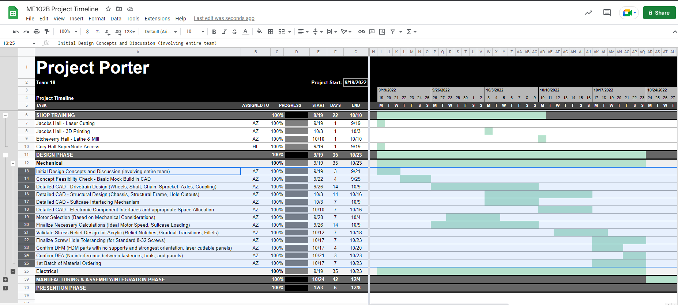
How Did I Keep Track of Everything?

Slide 4
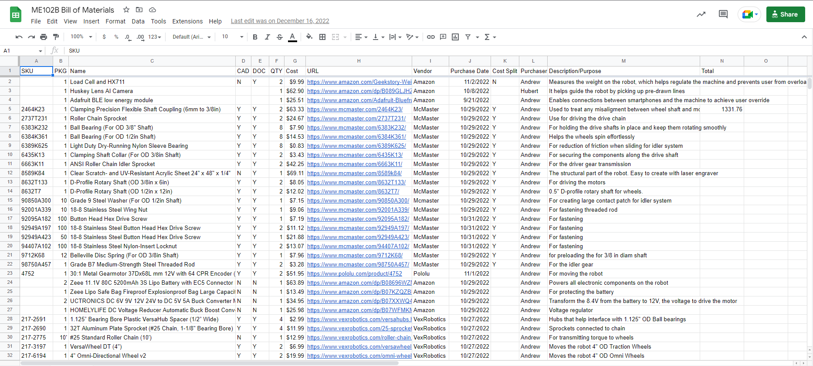
How Did I Keep Track of Everything?

Slide 5
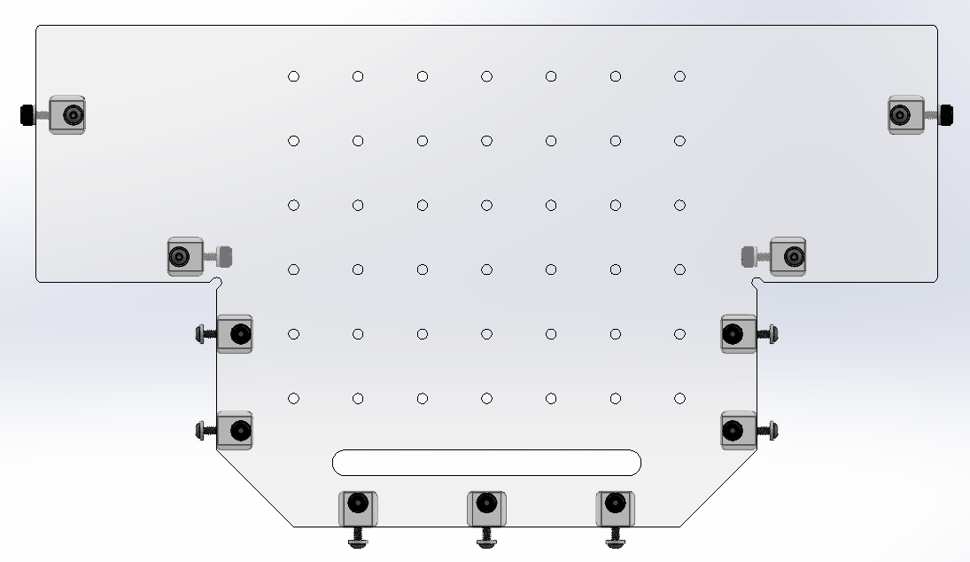
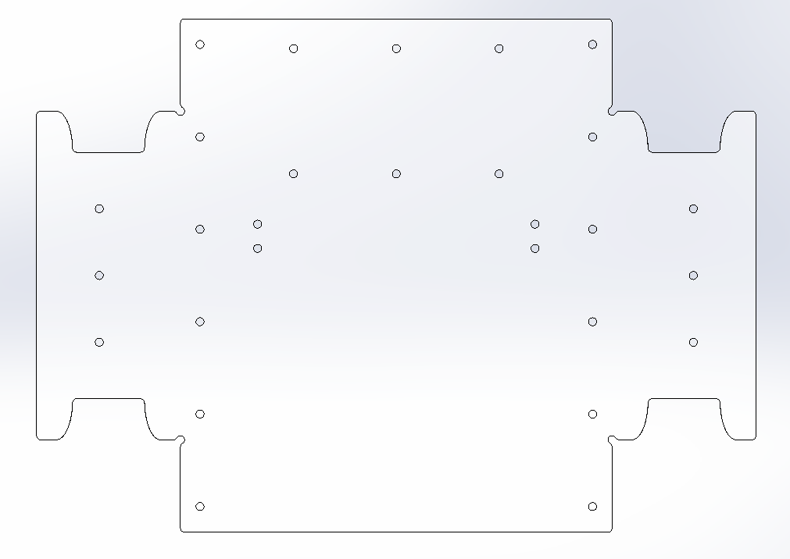
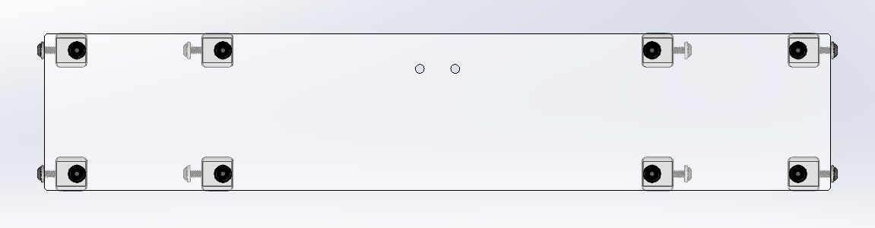
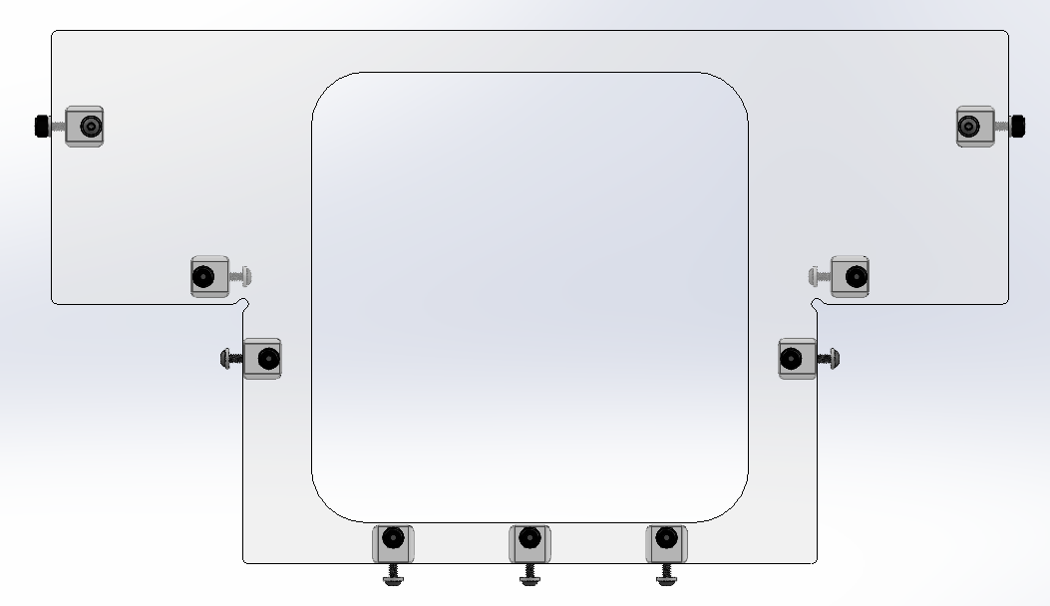
The Structural Frame
Rear Vertical Panel
Fillet
Relief Notch
Horizontal Panel
Front Vertical Panel
Floor Panel
x2
All the structural parts that connect the left and right drivetrains.

Slide 6
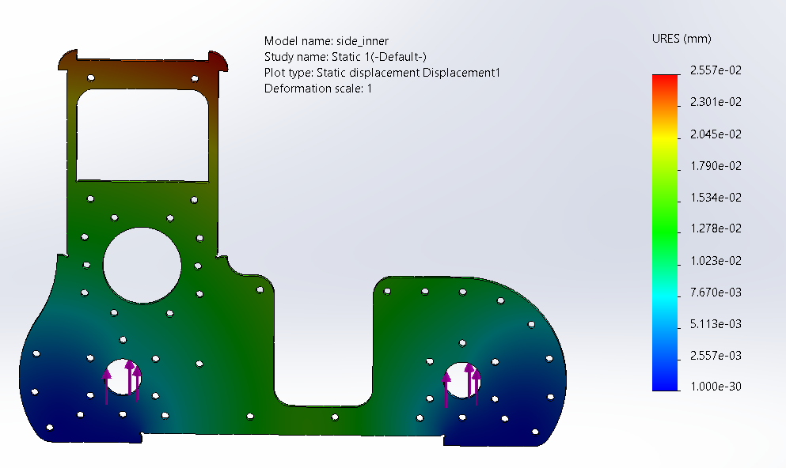
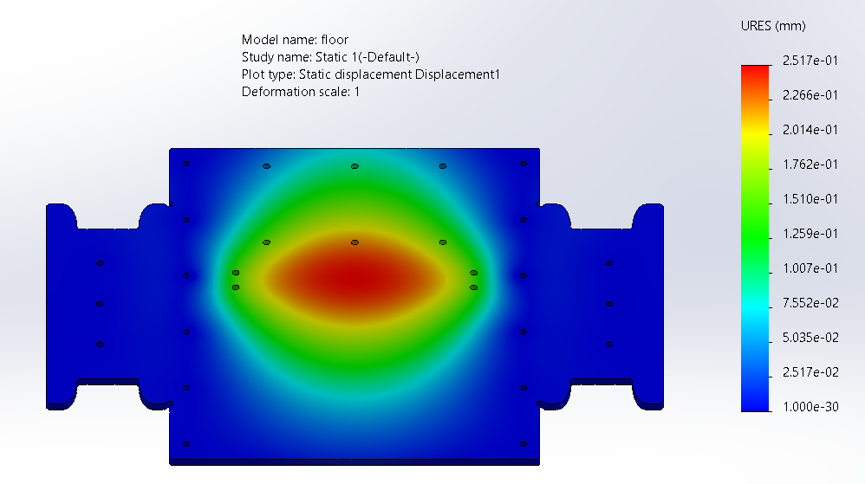
The Structural Frame
FOS: 8.1
FOS: 24

Slide 7
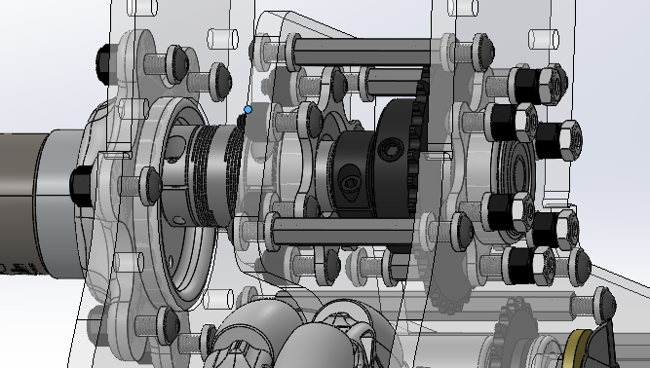
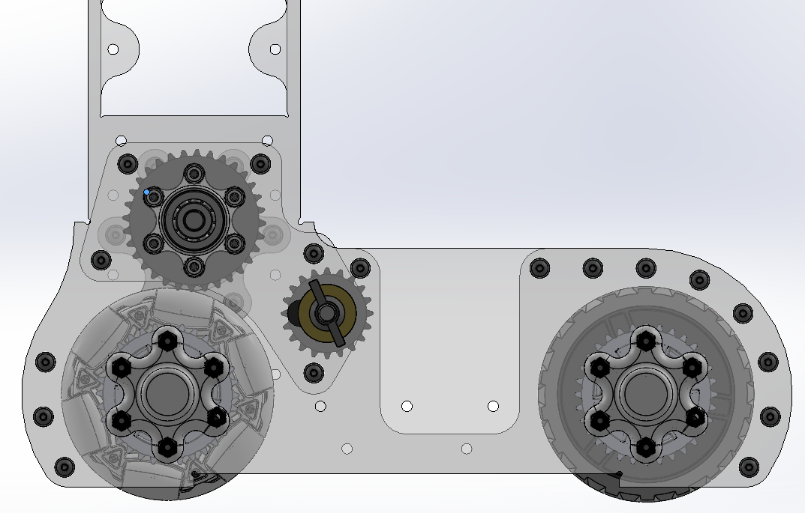
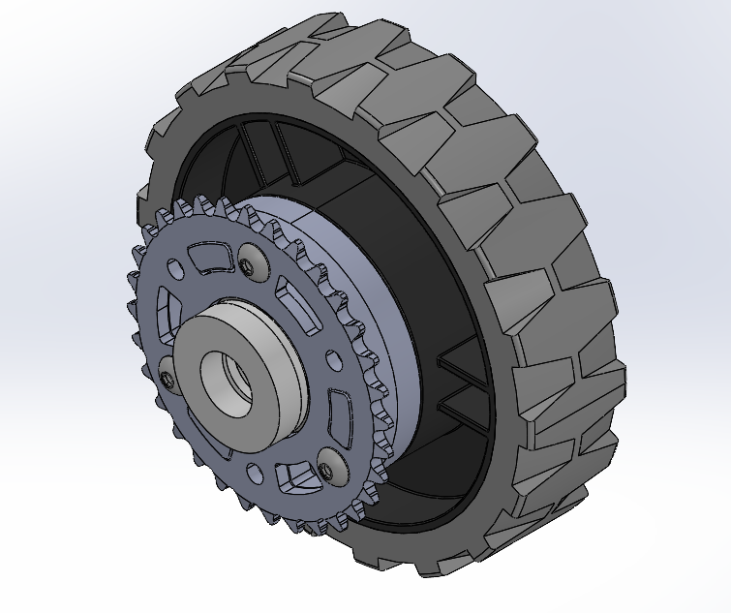
The Transmission
Drive Sprocket
Idler Sprocket
Flexible Coupling
Driven Sprocket
Omni Wheel
Roller Chain

Slide 8
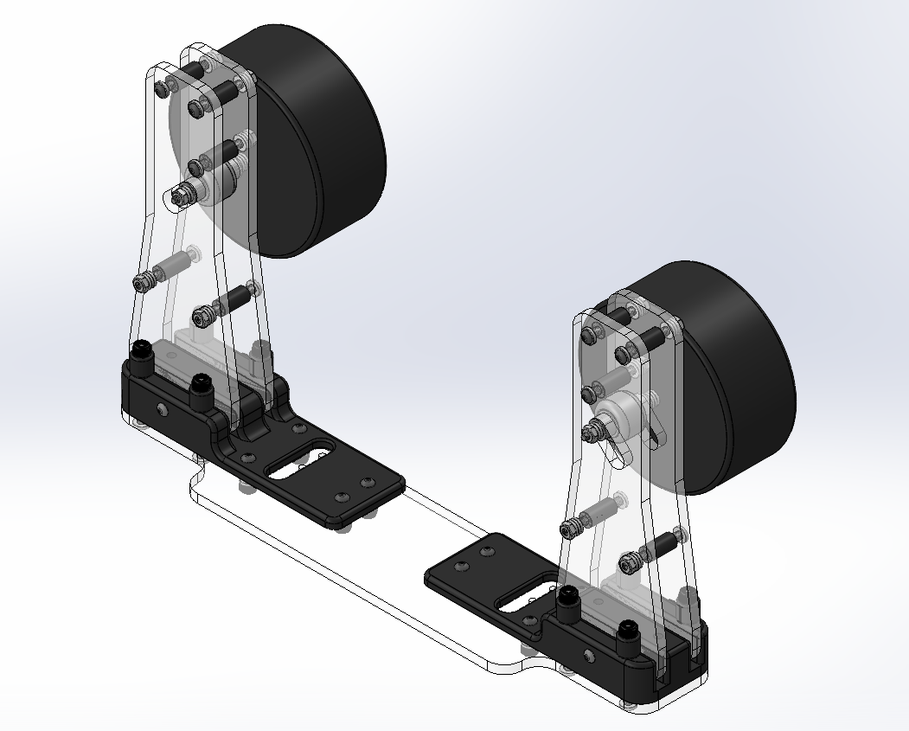
The Suitcase Interface Mechanism
Compliant, high friction, wheels
y
x
Inwards
Load cell attachment locations

Slide 9
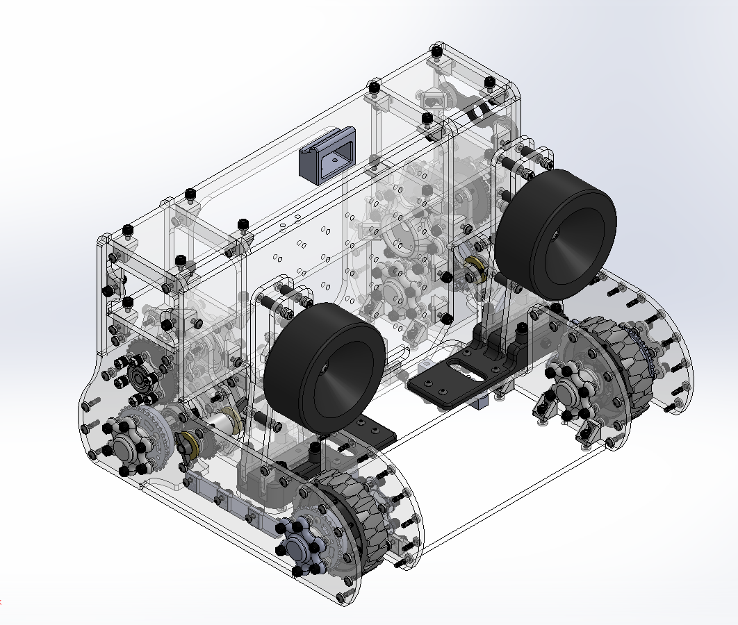
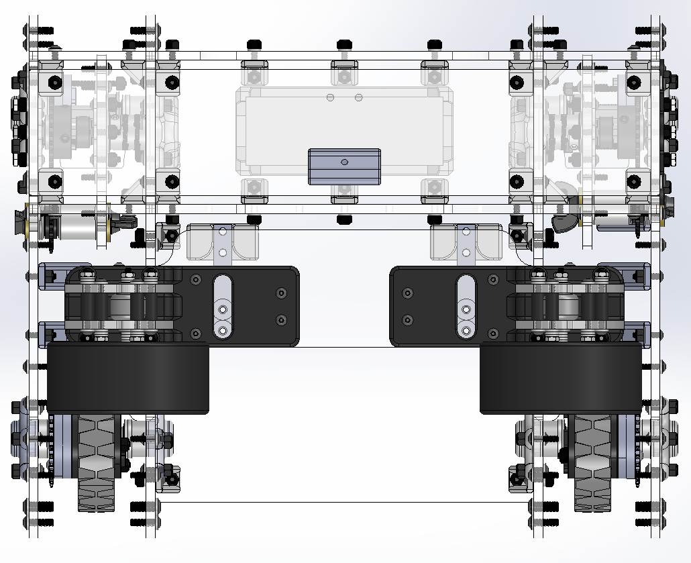
Assembled Together
Isometric Rear View
Top View

Slide 10
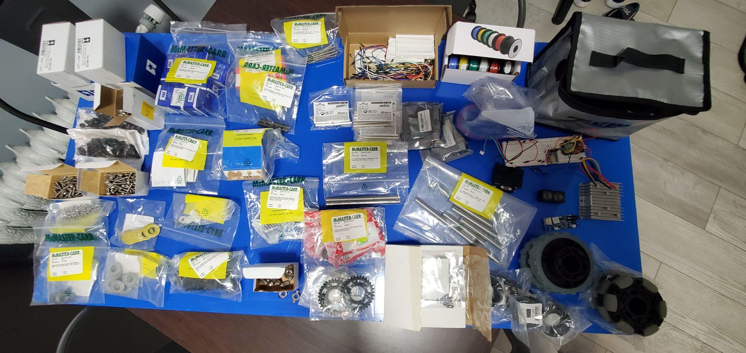
The Parts

Slide 11
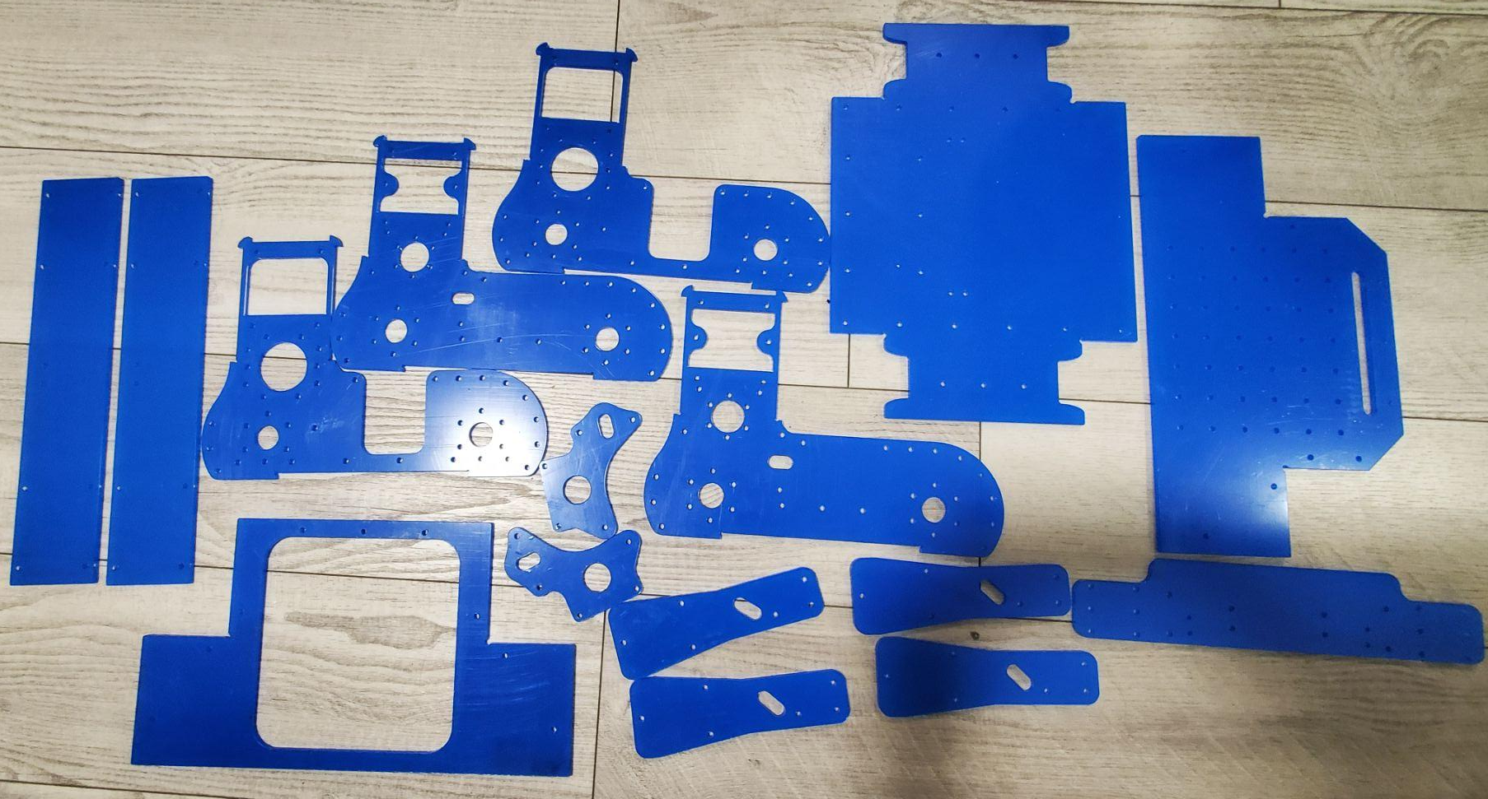

Laser Cutting
DXF File on 48inx24in Acrylic Sheet
(Very faint bc of line weights)
Laser Cut Panels

Slide 12
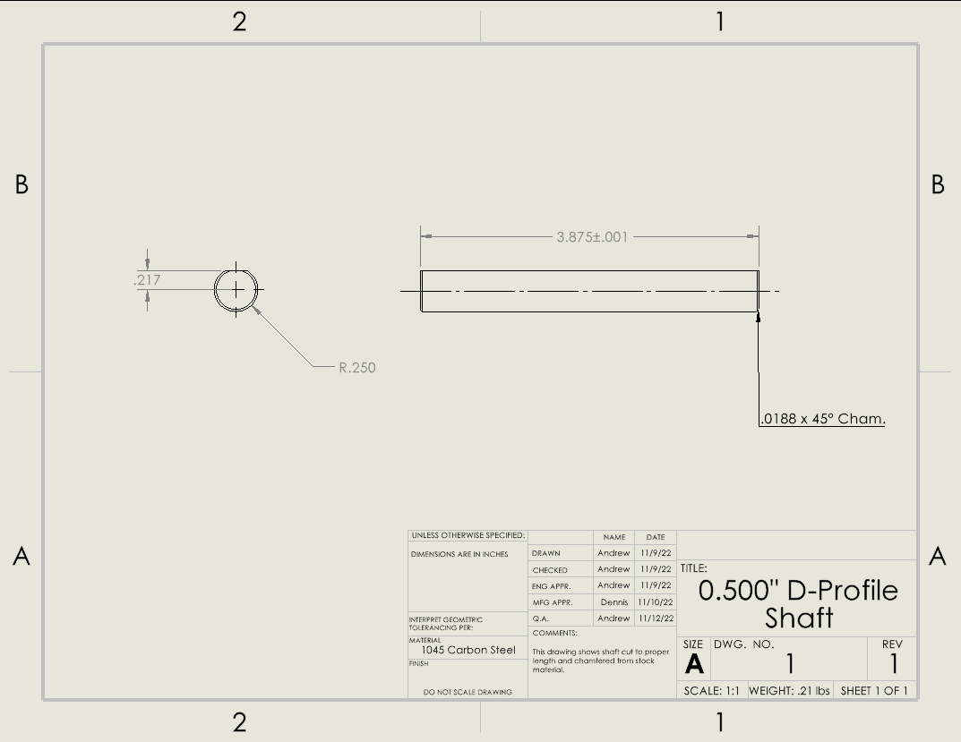
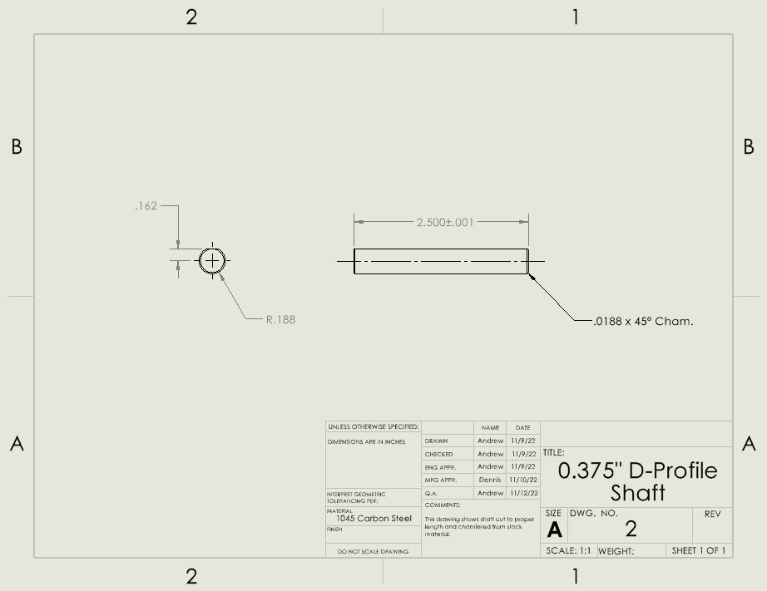
Machining
For Wheel Axles
For Driven Shaft

Slide 13
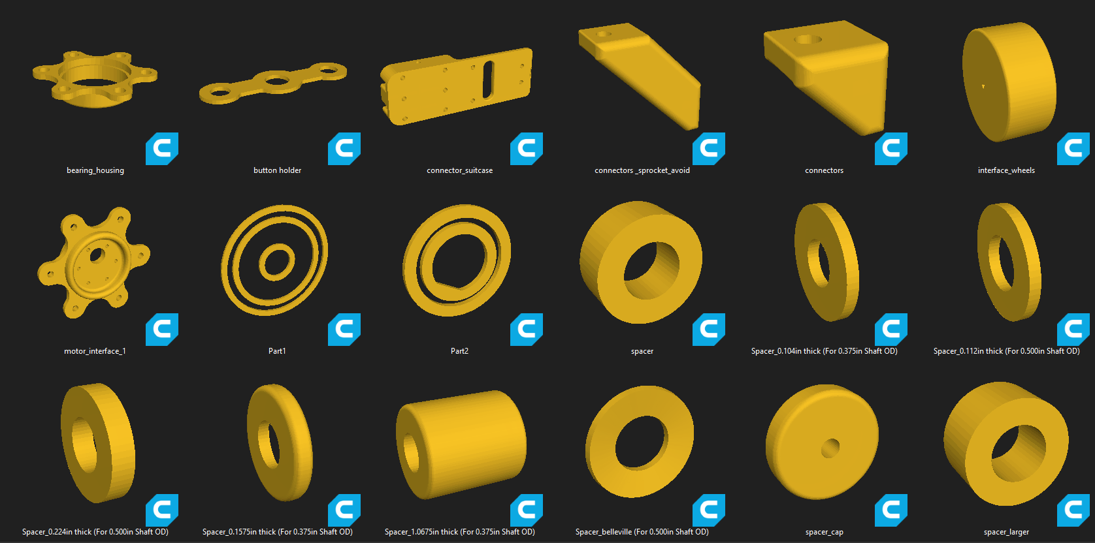
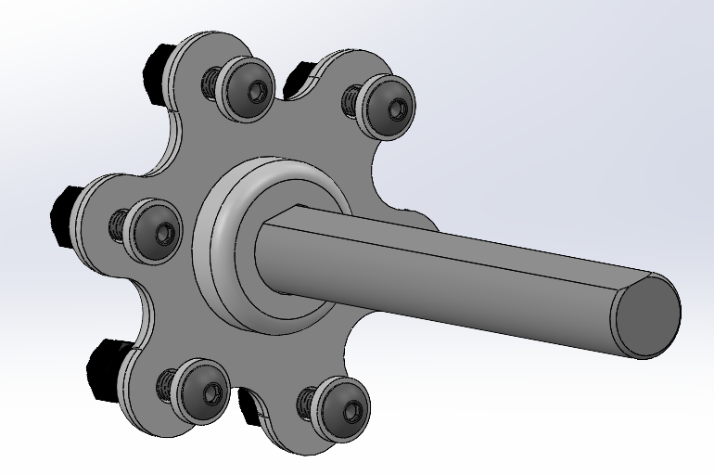
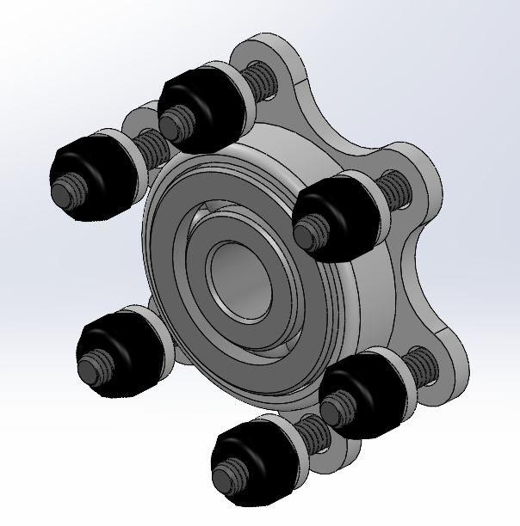
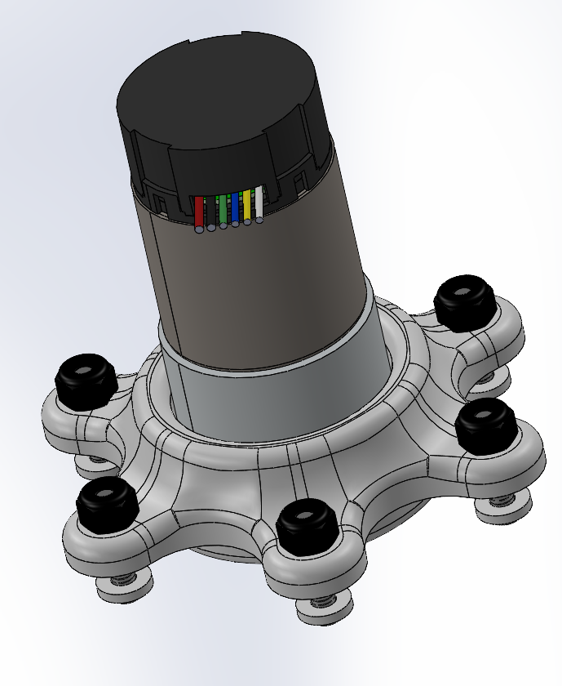
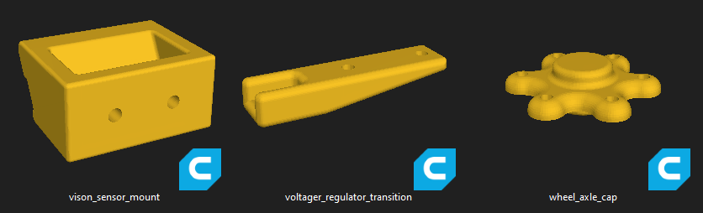
FDM Printing

Slide 14
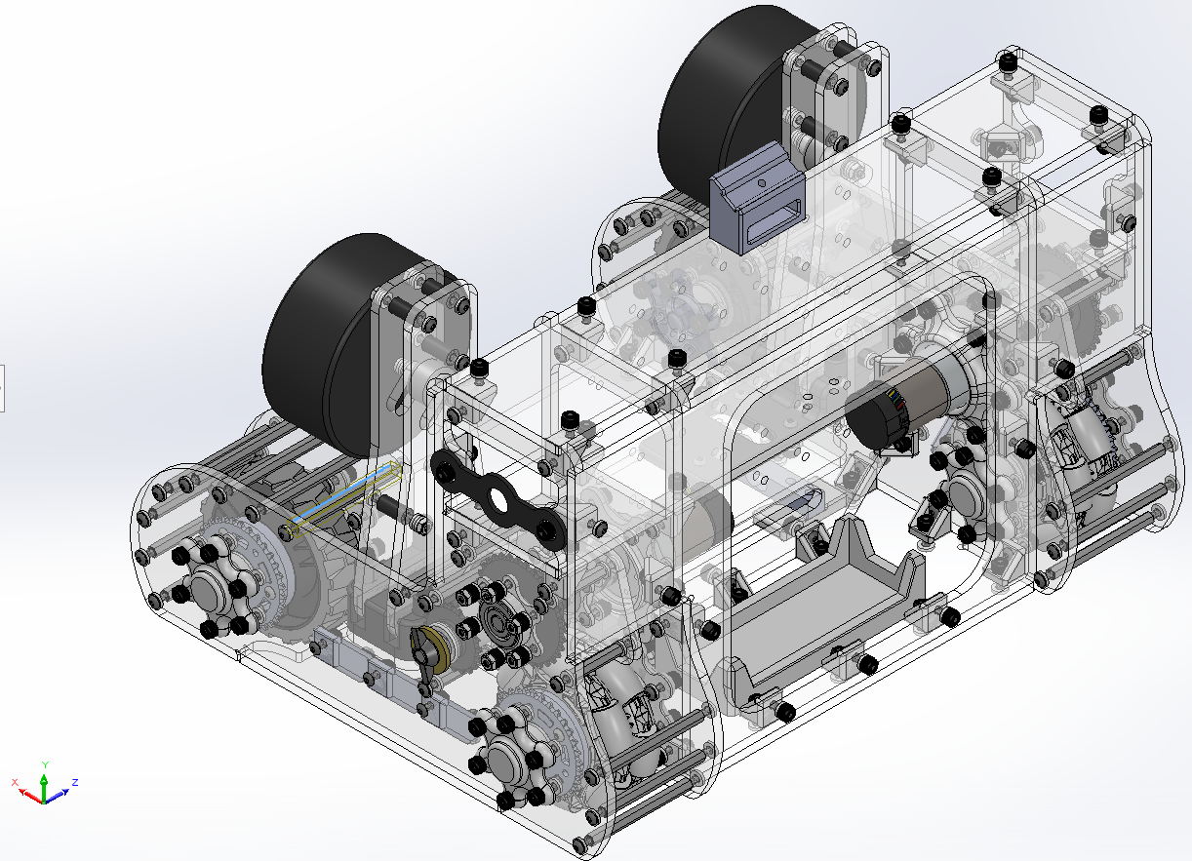
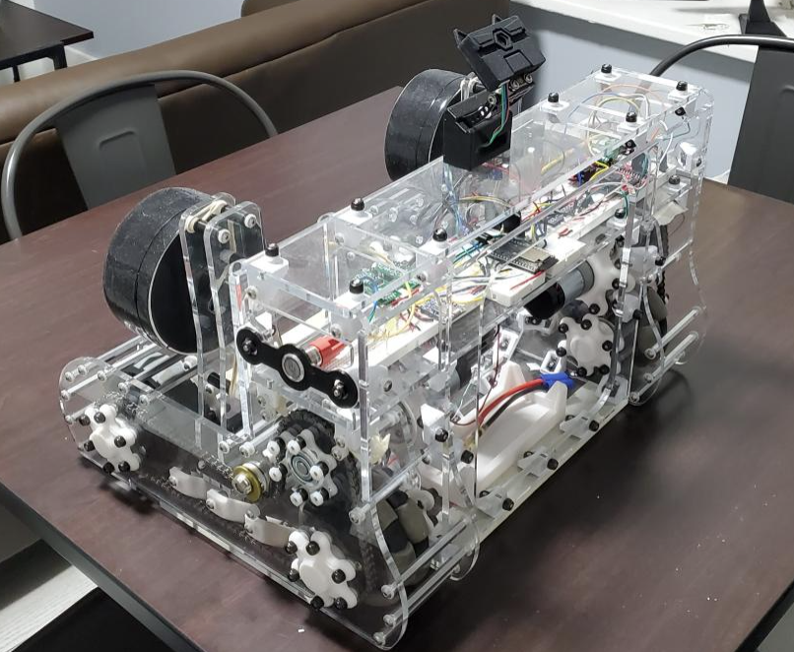
From Paper to Real Life

Slide 15
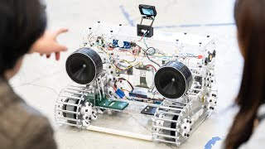
Showcase!

Slide 16
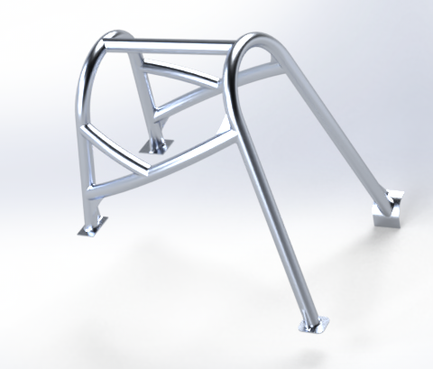
Project Roll Cage

Slide 17
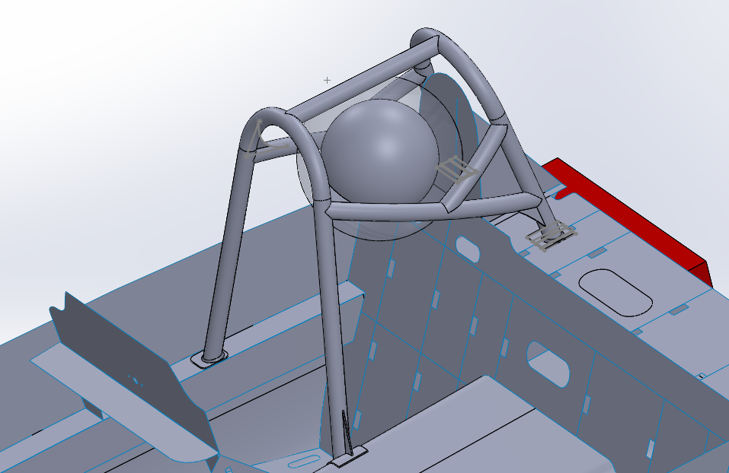
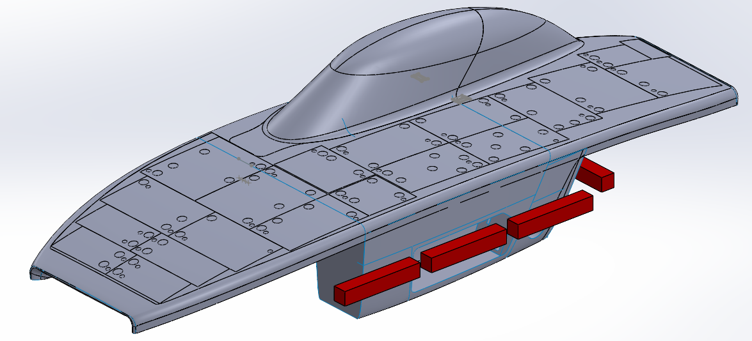
Roll Cage in the Vehicle
Modeled Driver + Helmet
50mm helmet to rollcage clearance sphere
Structural Chassis
Roll Cage Location
Top Shell
Canopy
Above Top Shell/Canopy
Underneath Top Shell/Canopy

Slide 18
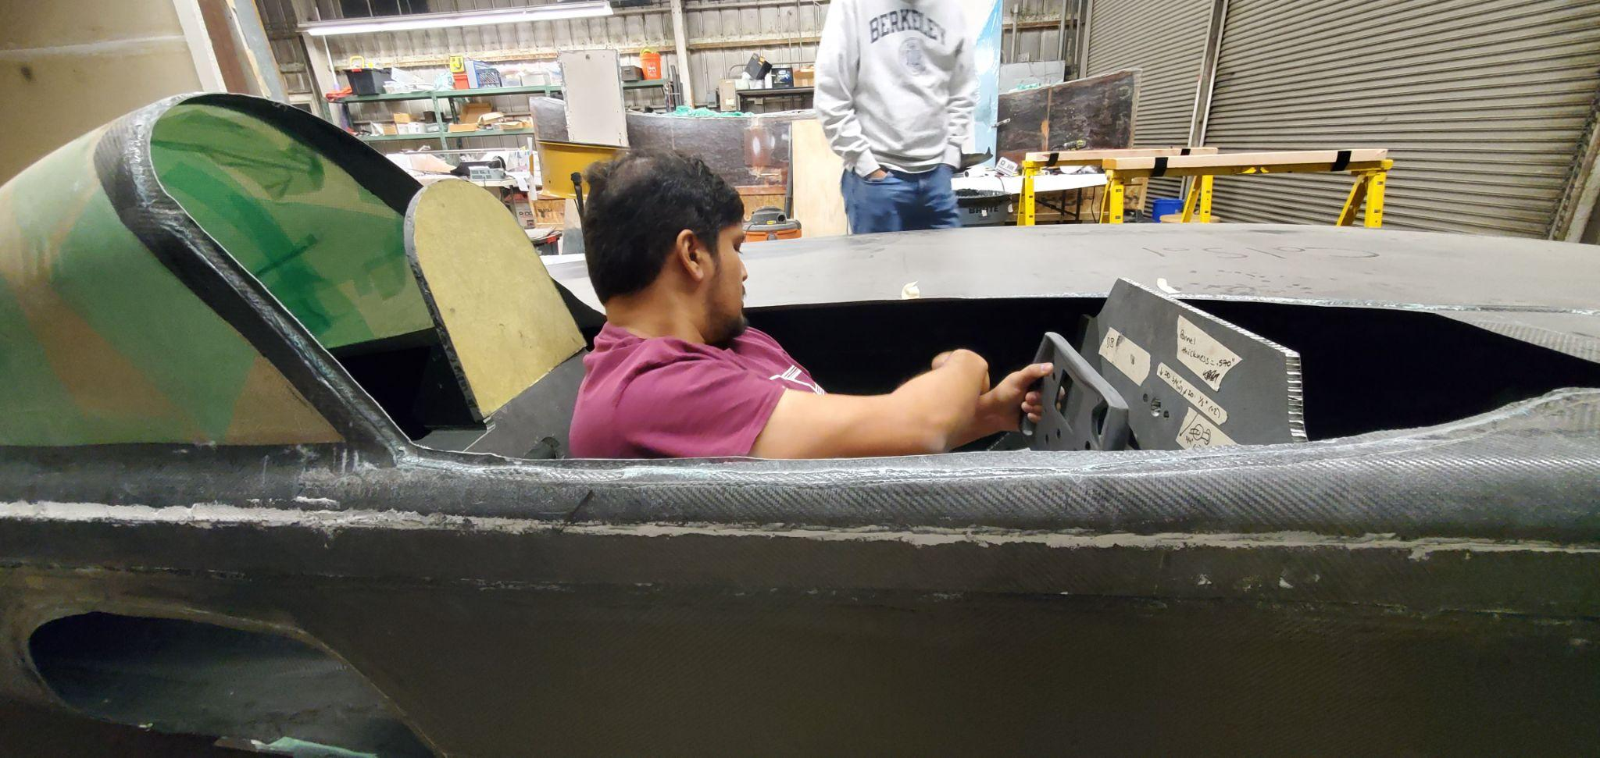
Our Car
Car with Top Shell on and team mate, Tristan in the Driver Cell.

Slide 19
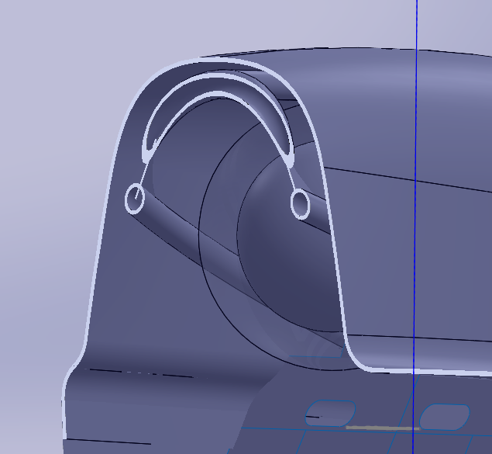
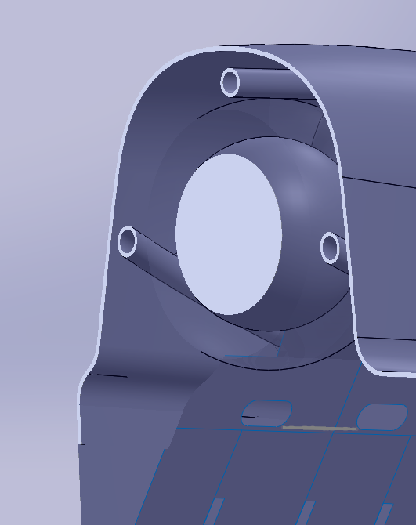
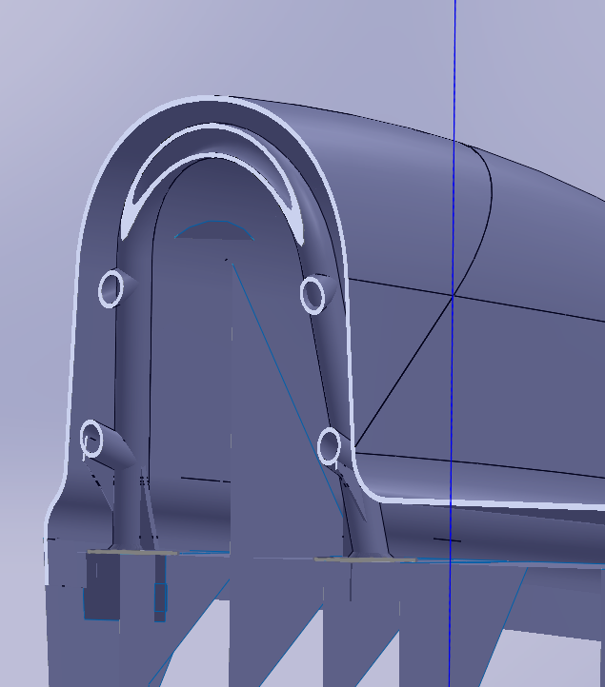
Issues I Tackled
Front Middle Rear
Notice the clearance of rollcage from canopy and transparent sphere in each image

Slide 20
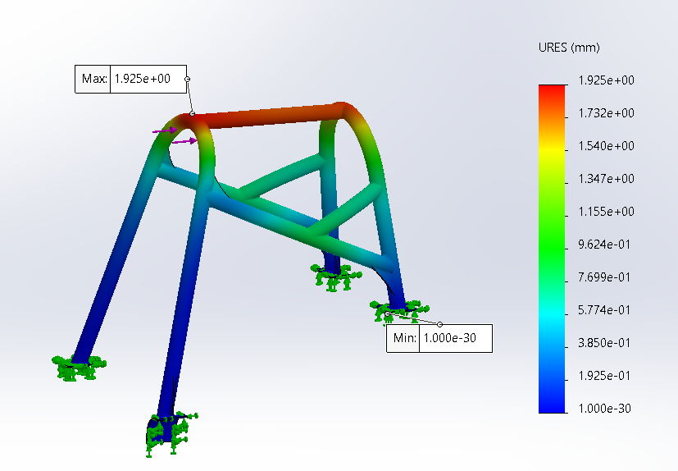
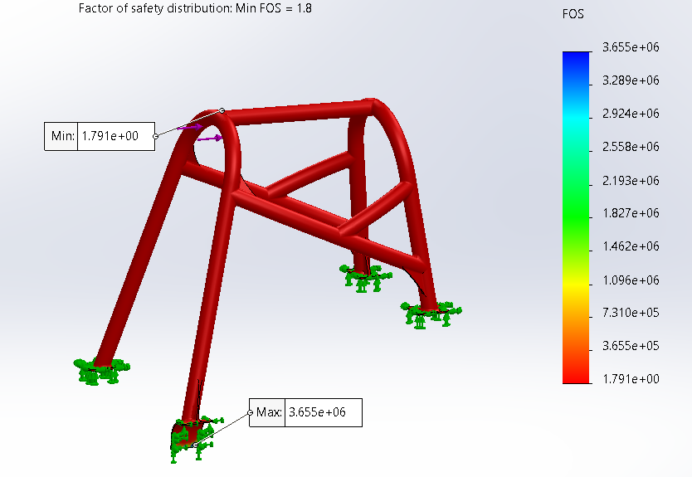
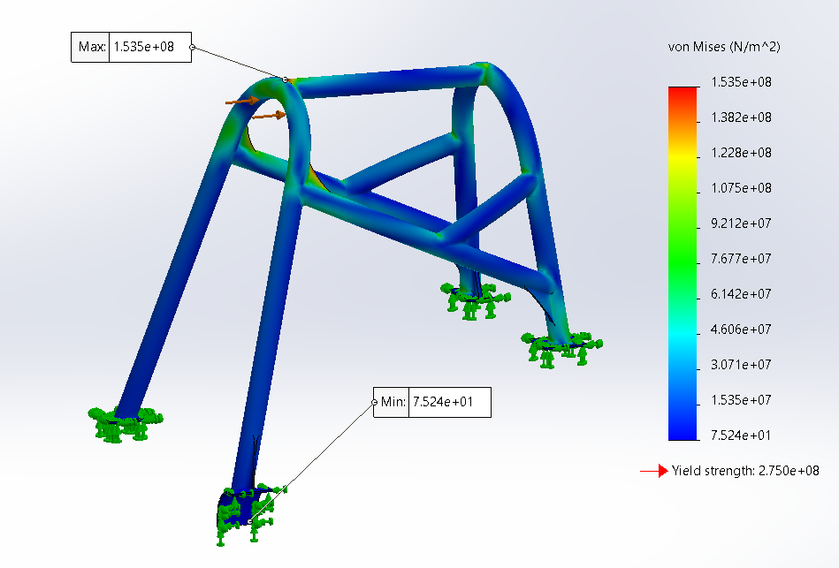
Issues I Tackled
Displacement FOS Stress
Less than 25mm max deformation and at least 1.1 FOS
Simulated in SolidWorks with tetrahedral element meshes

Slide 21
Moving Forward
Tempering to T4 (at Garner Heat Treatment Inc.)
Creating necessary jigs for notching and welding
Tube Bending (via Roll Bender and Rotary Bender)
Tube Notching (via tube notcher or hole saw with drill press)
Welding (via in house machinists Dennis)
Stress Relieve and temper to T6 (at Garner Heat Treatment Inc.)

Slide 22
THANK YOU

